Slide 1
The PACMAN PROJECT
Meet the PacMan
Avalle Giorgio & Cannas Carlo
Politecnico di Torino © 2015
Computer Architecture Project assignment

Slide 2

Introduction
The project has been entirely realized using the “ISE Design Suite”, from Xilinx © tools

Slide 3
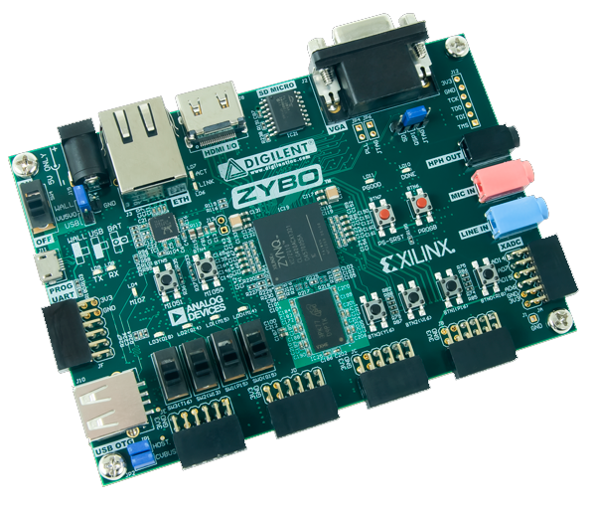
Introduction
The platform used is a
ZYBO Zynq™-7000 Development Board

Slide 4
The PACMAN
How the game works

Slide 5
Video output
Depending on the screen, two different video protocols are implemented:
- VGA: left most switch is off
- PAL: left most switch is on

Slide 6
The controller
In order to provide a better game experience, a joypad is included in the project.
It has been created using a breadboard and four push buttons, used to move the PacMan sprite in the maze

Slide 7
Pause screen
You can enter the pause mode turning on the right most switch

Slide 8
Ghosts
Each phantom has a different AI, in order to try making things apparently unpredictable.
Sometimes, the behavior of the ghost depends on other ghosts’ current state

Slide 9

BLINKY
The most aggressive one: he always targets the PacMan, trying to reach him

Slide 10

PINKY
The cleverest one: she tries to anticipate PacMan moves, closing the frontal way

Slide 11

INKY
The most complicated: the target is obtained doubling the distance between the PacMan and the leader, Blinky

Slide 12

CLYDE
…There’s an idiot everywhere

Slide 13
Levels
There are several different maps, according to the level
…Will you reach the last one?

Slide 14

MONTUSCHI MODE ON
A Paolo Montuschi’s tribute

Slide 15
Fighting for the break
Reaching a certain amount of points, prize snacks will appear: they’ll increase your score a lot!
REACH THEM, NO MATTER WHAT

Slide 16

Don’t make him angry
Ghosts, don’t underestimate your enemy… It could be dangerous

Slide 17
NO SPOILERS
Just enjoy the game!

Slide 18
Technical stuff
Yes, it will be boring

Slide 19
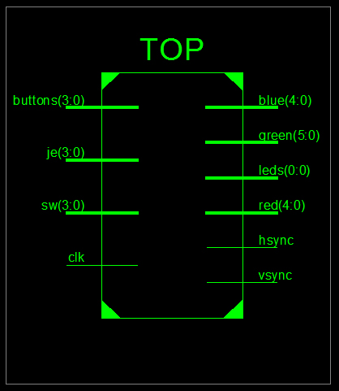
The TOP Module
Written in VHDL, it manages connections between submodules
Inputs:
- push buttons
- switches
- clock (125 MHz)
Outputs:
- colors
- sync signals
- LEDs

Slide 20
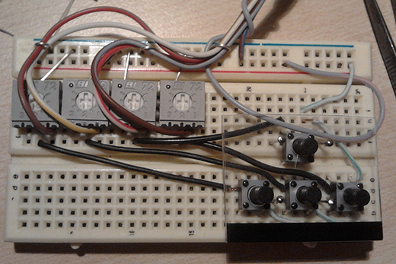
Push buttons
It is possible to play using onboard’s buttons (buttons) or joystick ones (je).
Commands are merged using an OR gate

Slide 21
Digital clock manager
Internal components need to work using a 25 MHz clock.
In order to convert the clock frequency this module is implemented
- Initial frequency: 125 MHz
- Resulting frequency: 25 MHz

Slide 22
PAL module
It works on a 12.5 MHz frequency.
Active if the left most switch is on
The second left most switch is the PAL mode:
- on: interlace
- off: progressive

Slide 23
VGA module
Implements the VGA protocol, working on a 25 MHz frequency.
Active if the left most switch is off (PAL mode disabled)
Screen size: 640 x 480 pixels
Color depth: 16 bits (RGB: 5-6-5)

Slide 24
VGA protocol
Row and column counters go beyond the visible screen size (480, 640)
I have to propagate sync signals at certain range values
- hsync: 656 – 751
- vsync: 490 – 491

Slide 25
Counter_RC module
Used in the VGA and GAME modules, in order to identify the current pixel.
GAME works using a 3 pixels offset, because of reading/writing memory delays

Slide 26
RAM module
Receiving as inputs the number of elements, the size of a row and a file name…
…It reads the specified file by rows, returning and storing its content.

Slide 27
RAM module
Sprites, tiles and map’s allowed movements are stored as hexadecimal values in separated files (which are read once).
When a level is completed or you loose the game, the map is redrawn.

Slide 28
Phantom’s AI module
Phantom data in input:
- Target cell
- Current cell
- Allowed movements (from “movements RAM”)
- Direction

Slide 29
Phantom’s AI module
Retrieves and return the next most convenient move for the ghost.
Clyde is the only one who needs a double control

Slide 30
And now…
The main module: GAME

Slide 31
GAME module
The core of the program
1556 code lines!
Spaghetti Code Alert!

Slide 32

GAME module
This is the core of the program. There are several phases, separated and ordered using pixel counters’ values.
Let’s zoom in…

Slide 33
GAME module: start
If the game has started, there are few seconds of pause: strings “READY?” and “GO!” are printed and the game starts.

Slide 34
GAME module: animations
Using an internal counter, I can manage waiting times for animations and allow ghosts to exit one by one.
The counter can assume different states: depending on the state, the maximum value to reach changes.

Slide 35
GAME module: pause
If the game pause switch is on, a pause menu (with transition and transparency) appears and the game freeze.
Counters are also frozen: no operation can modify the current state of the game

Slide 36
GAME module: phases
Visible area:
- Retrieve current map tile to draw
- Buttons’ input commands
- Sprite assignment to PacMan and ghosts
- Retrieve pixel values from memory

Slide 37
GAME module: phases
Invisible area (1):
- Calculate score
- Manage sprites’ state (including PacMan’s megapower)
- Manage prize snacks
- Manage collisions (a ghost eats the PacMan)

Slide 38
GAME module: phases
Invisible area (2):
- Calculate ghosts’ target cell
- Retrieve ghosts’ next move
- Sprites’ animations and movements
- Manage lives
- Manage counters
- Manage “stable” screens

Slide 39
GAME module: game over
When the game is lost, everything is reset:
- Sprites’ positions
- Counters
- Score, levels and lives
- Map cells
- …and so on.

Slide 40
GAME module: stable screen
We call a screen “stable” if, at that moment, every sprite is perfectly aligned to the map grid
This screen state is useful, because allow us to understand when some events occur (for instance, move sprites without intersect walls)

Slide 41
Last technical details
For further information, see the code

Slide 42
Manage movements
A predefined RAM module stores allowed movements as hexadecimal values, for each map cell
The idea is to observe the number in binary…
Every position correspond to a direction: the value ‘1’ means that the movement is allowed
Example: A = 1010
Left: 1 -> ok
Up: 0
Down: 1 -> ok
Right: 0

Slide 43
Manage movements
When the screen is stable, I can set the next movement for each sprite.
Every time the screen is completely drawn, I can move sprites and manage their animation.
In the megapower mode, the PacMan doubles its speed: eaten ghosts have to return to the Ghosts’ House and regenerate

Slide 44
Memory implementation
Memory items are always implemented as vectors.
In order to have a correspondence with the game map (which is a matrix) and retrieve the cell index, I have to multiply #row per the line size and then add #col.
Map tiles: 16x16 pixels
Animated sprites: 24x24 pixels
Text: 7x7 pixels (printed as 14x14)

Slide 45
Enjoy your match!

Slide 46
Credits
Authors:
- Avalle Giorgio (S200994)
- Cannas Carlo (S201705)
Ghosts images (slides only):
- StrawberryStar123 (http://strawberrystar123.deviantart.com)
FPGA information
(https://www.digilentinc.com/Products/Detail.cfm?Prod=ZYBO)

